Slide 1
EECT-111
Lab Notebook
Intro to circuit analysis
Fall 2019
James Zartman
Lab partner: Shannon Wilson
12/20/19

Slide 2
Table of contents
Lab 1-Resistor Variablility Slide 4-7
Lab 2- Sorting and Reading Resistors Slide 8-10
Lab 3- Series Resistors Slide 11-16
Lab 4- Black box design (series circuit) Slide 16-20
Lab 5- MEMs Variable Resistor(Modified) Slide 21-23
Lab 6- Black box design (parallel circuit) Slide 24-27
Lab 7- Resistor Parallel Circuit Slide 28-31

Slide 3
Table of contents cont.
Lab 8- Black Box Design 3 Slide 32-35
Lab 9- Series/Parallel Resistors Slide 36-38
Lab 10- Series/Parallel Capacitors Slide 39-

Slide 4
Lab 1-Resistor Variability
Objective:
  The purpose of this lab was to get twenty random resistors, all of the same resistance, and measure them to see how much they vary in resistance.
Equipment used:
  Digital multimeter
  20- 1k ohm resistors
  Bread board

Slide 5
Lab 1-Resistor Variability
Procedure
  Picked out 20 resistors that were all the same color code and were 1k ohm resistors.
  Put them all on the bread board horizontally from top to bottom
  Switched the multimeter to read ohms
  Read the resistance of all 20 resistors and put the values in excel to get calculations for min, max, average, and standard deviation of the 20 resistors tested.

Slide 6
Lab 1-Resistor Variability
1 | 990.9 | Ω
2 | 995.8 | Ω
3 | 1005.2 | Ω
4 | 984.6 | Ω
5 | 982.7 | Ω
6 | 991.5 | Ω
7 | 980.9 | Ω
8 | 1002.9 | Ω
9 | 990.1 | Ω
10 | 987.1 | Ω
11 | 1001.8 | Ω
12 | 986.2 | Ω
13 | 992.1 | Ω
14 | 990.8 | Ω
15 | 1003.5 | Ω
16 | 989.1 | Ω
17 | 990.1 | Ω
18 | 979.2 | Ω
19 | 994.9 | Ω
20 | 988.3 | Ω
Ave = | 991.4 | Ω
Min = | 979.2 | Ω
Max = | 1005.2 | Ω
Std dev = | 7.45 | Ω
The plot of the 20 resistors to show variablitlity and the data in Excel
Tolerance
High | 1050 | Ω
Low | 950 | Ω

Slide 7
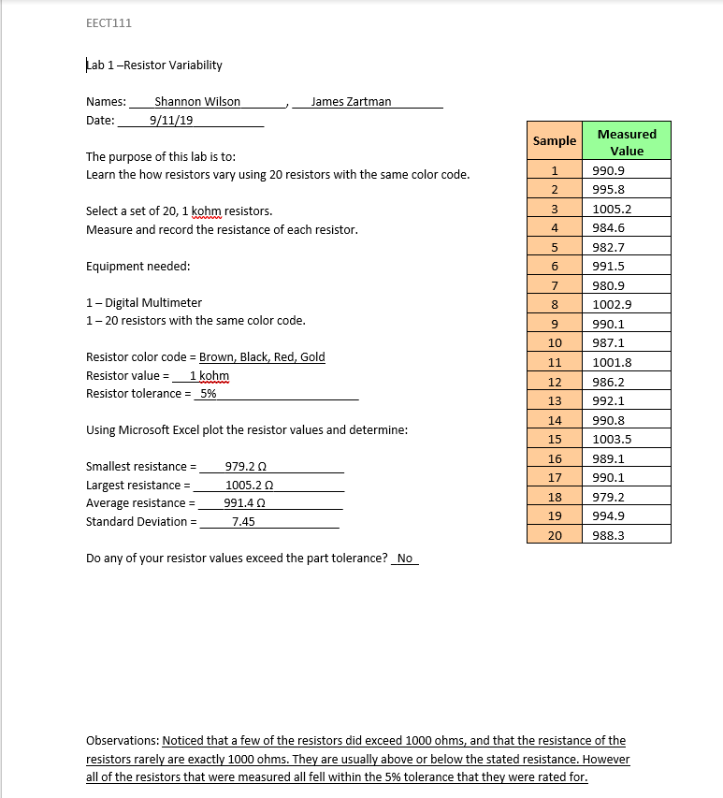
Lab 1-Resistor Variability
Observations:
Noticed that some of the resistors did exceed 1000 ohms, and that the resistance of the resistors are usually never exactly 1000 ohms.
The resistance is usually above or below the stated resistance.
The variation did however fall within the allowable 5% tolerance for each resistor.

Slide 8
Lab 2- Reading and sorting resistors
Objective:
  To learn how to read resistors value by the color bands on the resistors. Then to sort the resistors from smallest to largest on the bread board measuring them with a multimeter to verify the order.
Equipment used:
  Digital multimeter and 15 unique resistors.

Slide 9
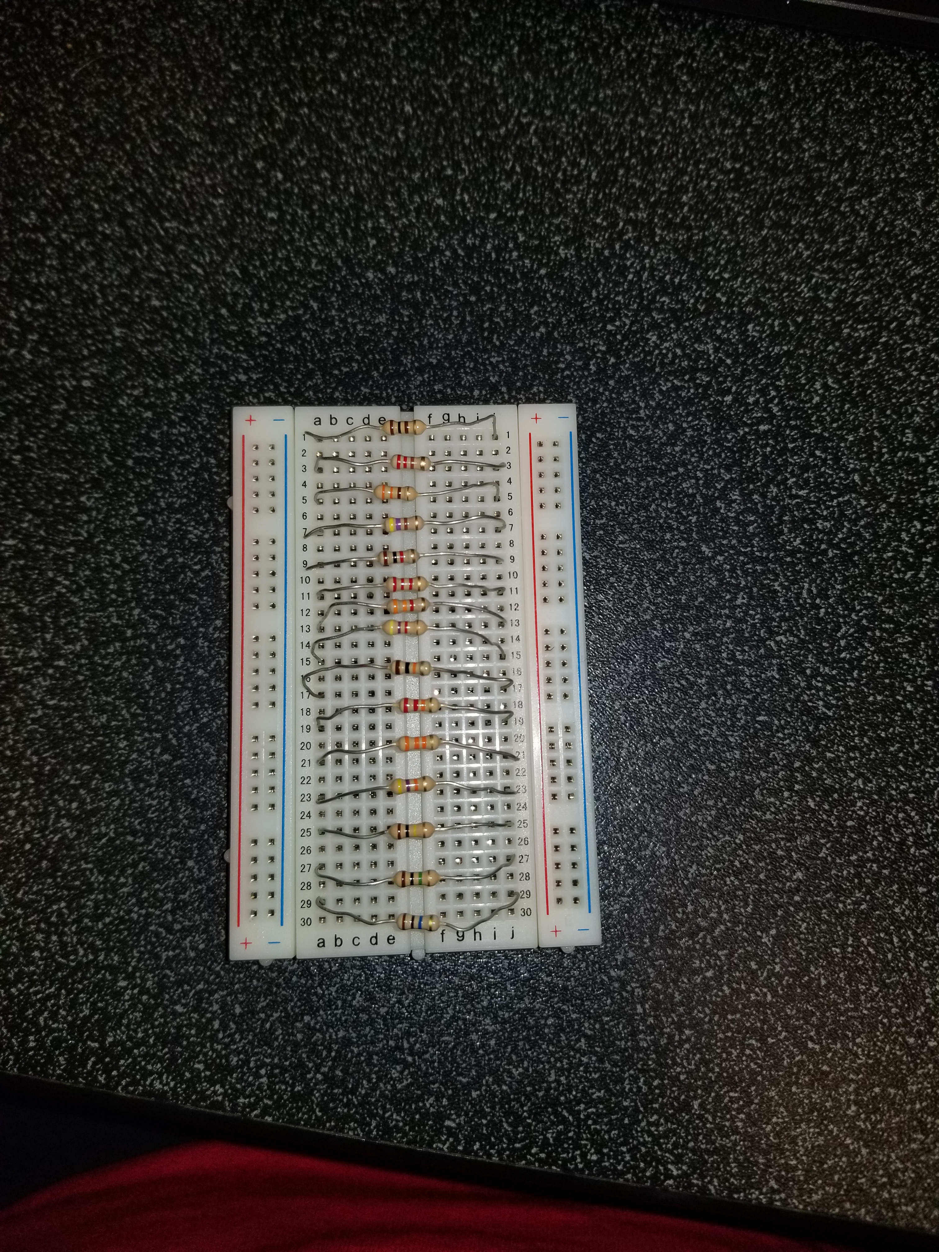
Lab 2- Reading and sorting resistors
Procedure
  Pick out the 15 unique resistors
  Build a resistor kit ordering them from smallest resistance to largest resistance.
  Measure all the resistors with the multimeter to verify that the order is correct.

Slide 10
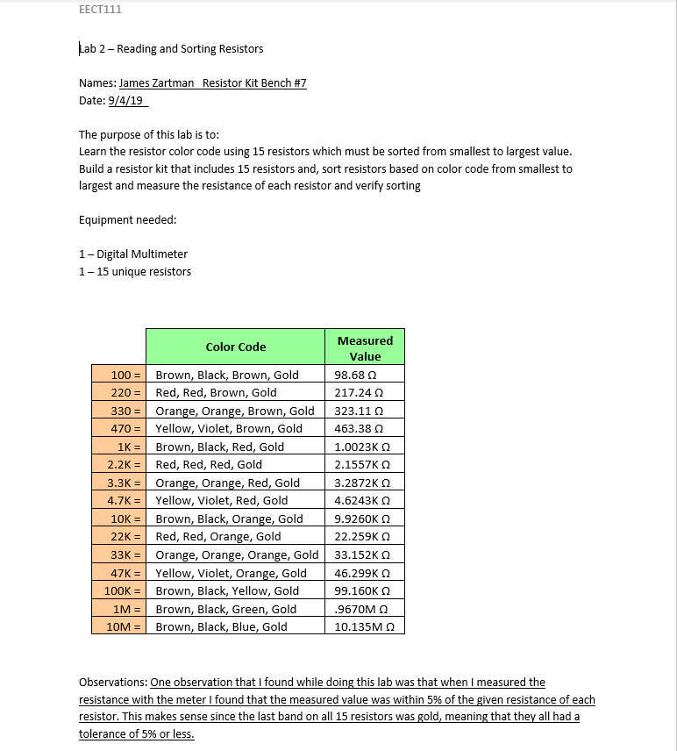
Lab 2- Reading and sorting resistors
Observations
  We did not have to do a simulation or any calculations for the this lab
  The lab worked out like it was supposed to
    The values of the resistors were within the 5% allowable tolerance. This makes sense since the last band on all of the resistors were gold. Indicating a tolerance of 5%.

Slide 11
Lab 3- Series Resistors
Objective:
  To experiment with series circuits and verify by simulation and by measuring that the test results all agree.
Equipment Needed:
Digital Multimeter, Elvis II (power supply), Resistors called out in lab, bread board, and jumper wires.

Slide 12
Lab 3- Series Resistors
Procedure:
  Had to calculate the results in excel and then simulate them in Multisim
  Gather equipment needed to complete the lab
  Measure the value of each resistor and then build the circuit shown in the lab on the bread board.
  Measure the total resistance which is RT
  Then connect the circuit to 9 volts of power (Elvis II)
  Measure the current and voltages asked for in Lab using the multimeter

Slide 13
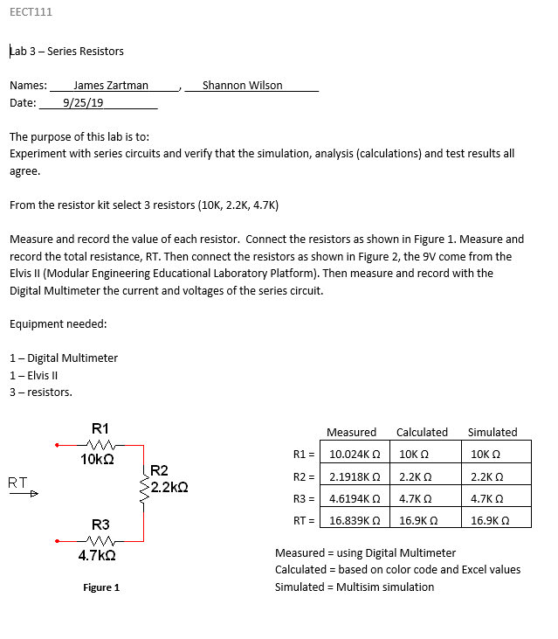
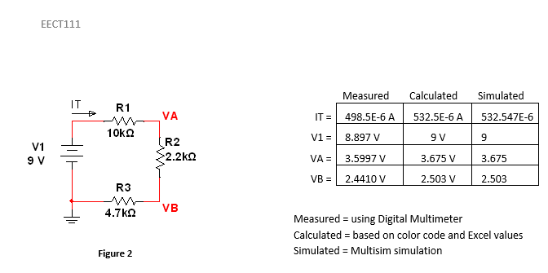
Lab 3- Series Resistors
This is the lab and we got the simulated and calculated values before going to the lab to build the circuit.
The calculated values were done in excel and the simulations were done in multisim. Both were the exact same values

Slide 14
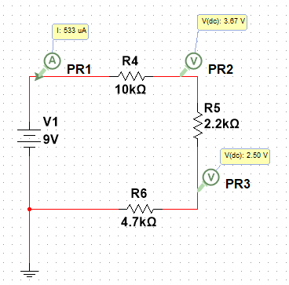
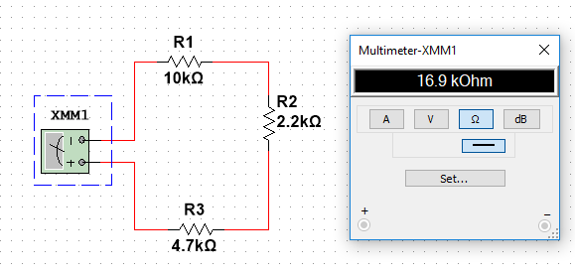
Lab 3- Series Resistors
Calculations and simulation
V1= | 9 | V
R1= | 10.00E+3 | Ω
R2= | 2.20E+3 | Ω
R3= | 4.70E+3 | Ω
RT= | 16.90E+3 | Ω
IT= | 532.5E-6 | A
VA= | 3.675E+0 | V
VB= | 2.503E+0 | V
R1= | 10.0E+3 | Ω
R2= | 2.2E+3 | Ω
R3= | 4.7E+3 | Ω
RT= | 16.9E+3 | Ω

Slide 15
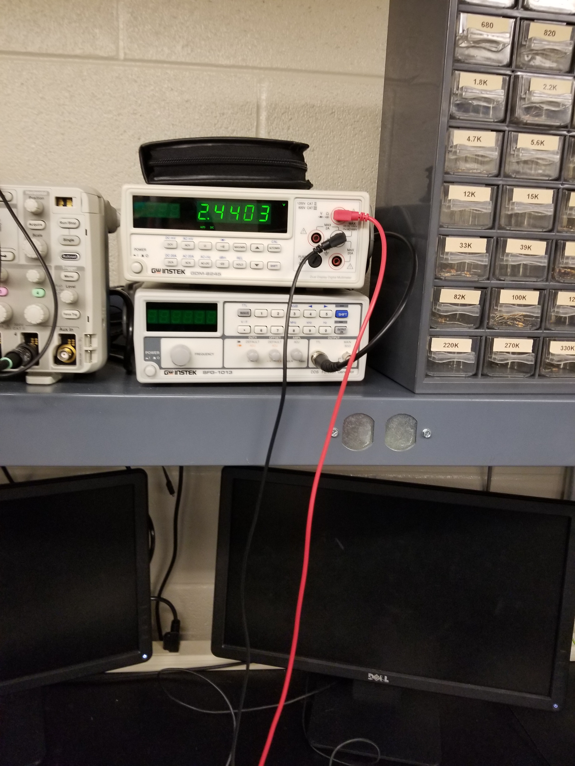
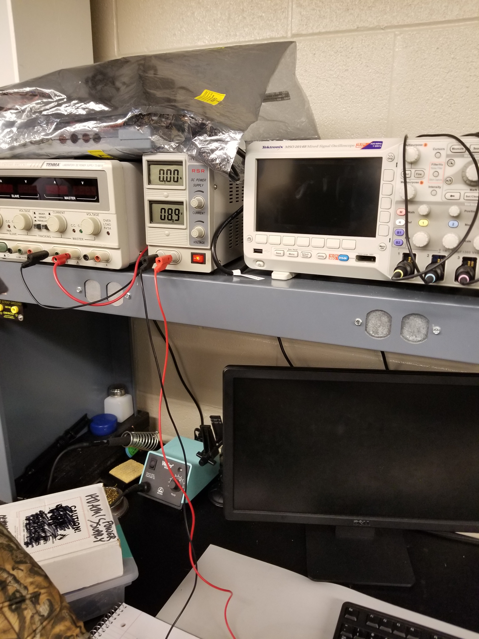
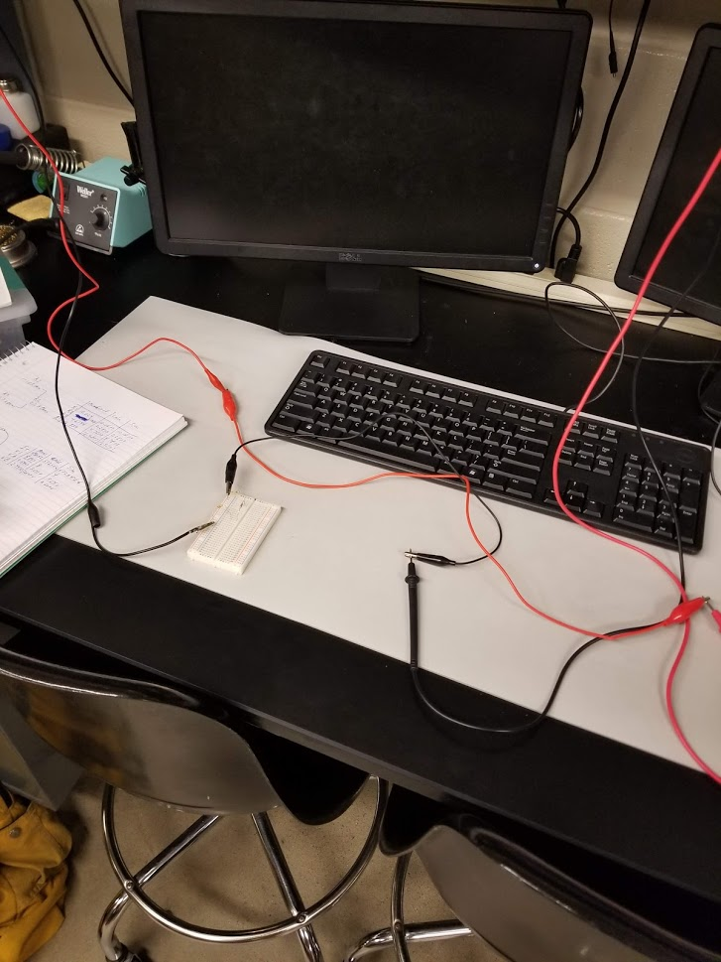
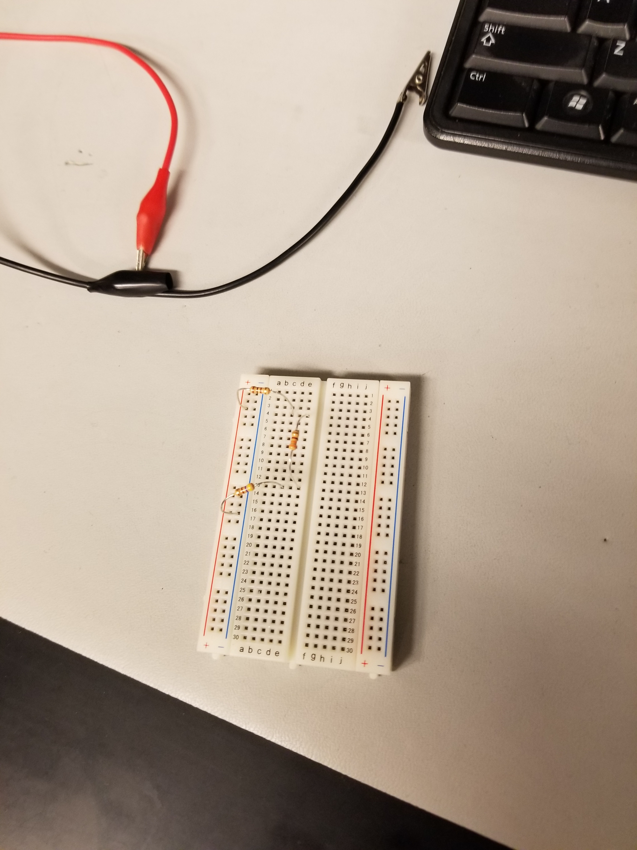
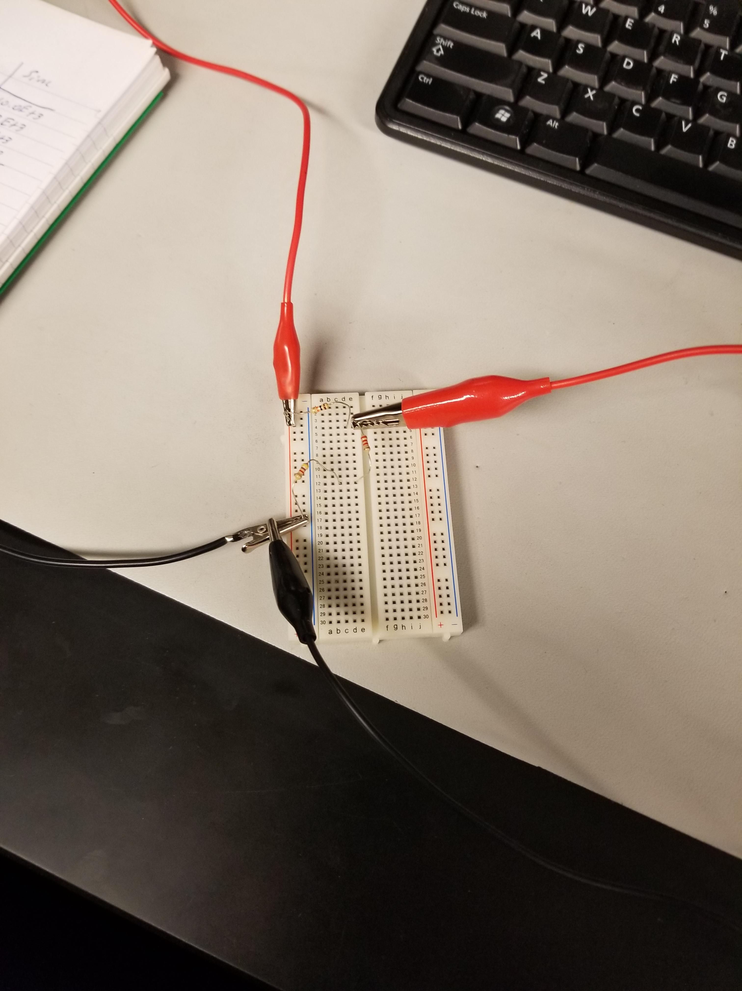
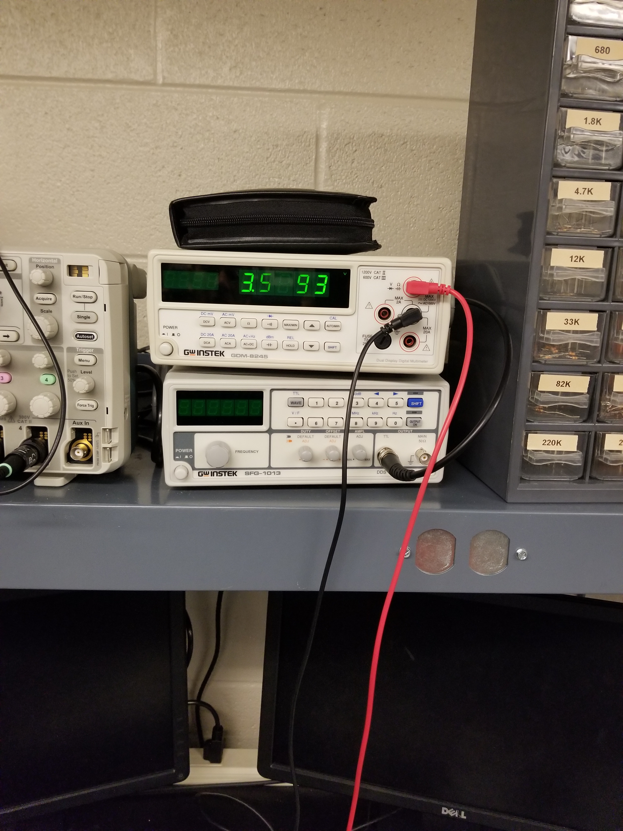
Lab 3- Series Resistors
Pictures of setup and measurments

Slide 16
Lab 3- Series Resistors
Observations:
  We found that when taking pictures on the digital multimeter sometimes the numbers would not show up.
  It was a learning experience on how to measure current of a circuit and to measure the voltage.
  Found it to be very problematic to take measurements of the circuit without the use of alligator clips. The use of them made it so much easier to get the proper measurement and to then capture a picture of the results.
  The measured results differed a little from the calculated and the simulated. This can be attributed to the tolerances allowed in the resistors and the fact that we didn’t quite have the power supply set to 9 volts. It was only at 8.9 volts. So human error plays into the difference of results as well.

Slide 17
Lab 4 – Black box design (Series circuit)
Objective
  To learn about series circuits and be able to figure out the combination of 3 resistors that when hooked up in series would make the diagram provided on the lab true.
Equipment used:
  Digital multimeter, wires, DC power source, Bread board, Resistors: 100 ohm, 330 ohm, and 470 ohm

Slide 18
Lab 4 – Black box design (Series circuit)
Procedure
  First calculated the Total resistance based on ohms law and solving for resistance.
  Knowing the total resistance then we could figure out what 3 basic resistors we needed to use to get the correct current.
  Simulated it
  Went to lab and built the circuit and then tested the circuit to see if the measured values lined up with the calculations and the simulation.

Slide 19
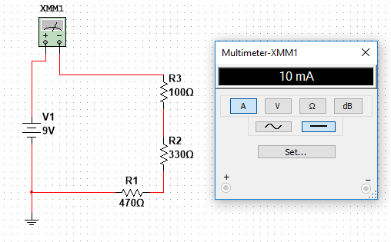
Lab 4 – Black box design (Series circuit)
V1= | 9 | V
IT= | 10.0E-3 | A
RT= | 900 | Ω
R1= | 100 | Ω
R2= | 330 | Ω
R3= | 470 | Ω
RT= | 900 | Ω
As you can see we found that using a 100Ω, 330Ω, and a 470Ω resistors in series yielded the current that we were looking for with the supplied voltage of 9 volts.

Slide 20
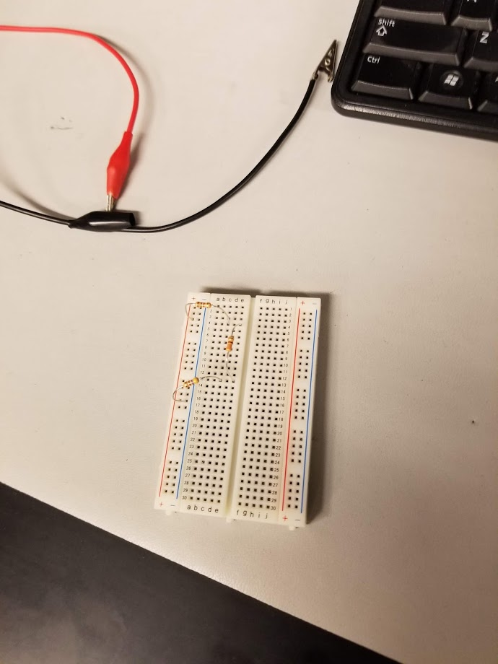
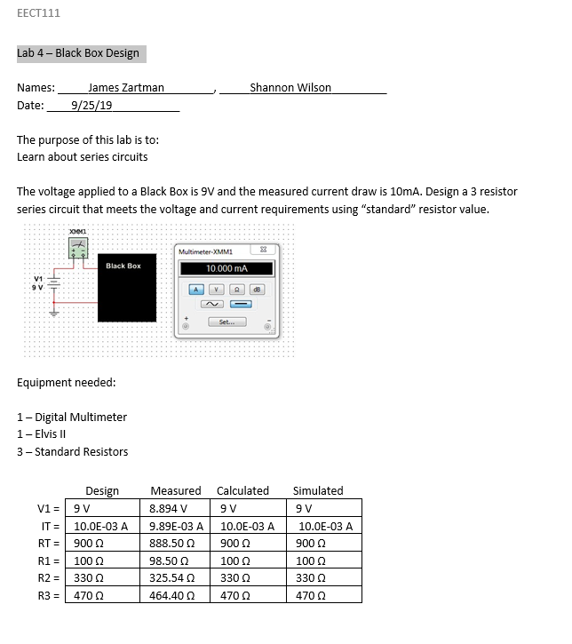
Lab 4 – Black box design (Series circuit)
Observations:
The measured values were very similar to the calculated and the simulated values.
The use of Ohms law is abundant and is very useful to solving problems such as this black box design.
Checking for current is an important tool to have and when its not done properly it can damage equipment or harm yourself

Slide 21
Lab 5- MEMs Variable Resistor (modified)
Objective:
  The purpose of this lab was to learn about variable resistors and to learn and build a Wheatstone bridge.
Equipment Used:
  Digital Multimeter, 2-10k ohm resistors, 1-1k resistor, 5k potentiometer, breadboard, and jumper wires
Procedure
  Simulated the circuit in Multisim because there were no calculations for this Lab.
  Got the results and went to the lab and built the circuit using the resistors and 5k pot.
  Troubleshoot circuit to make the 5k pot work
  Adjust the screw on top of the 5k pot to get the min, null, and max values of the variable resistor and record the data.
  Set the circuit up to measure VA-VB and then change the variable resistor to marks made in previous step to record the voltage for the min, null, and max values

Slide 22
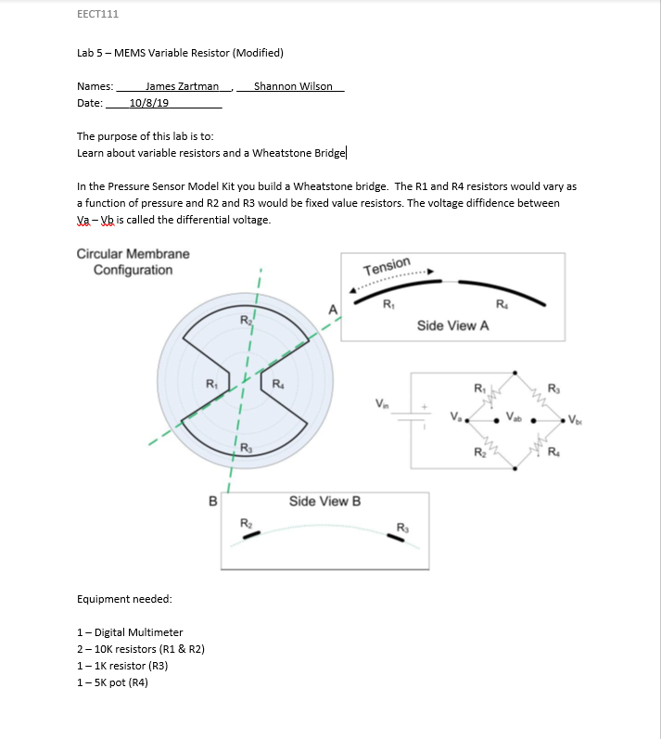
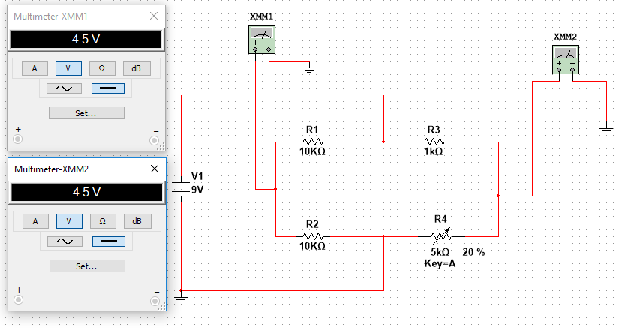
Lab 5- MEMs Variable Resistor (modified)
Here are the results we got for simulated and the measured results along with the lab and the simulation that was done in Multisim.

Slide 23
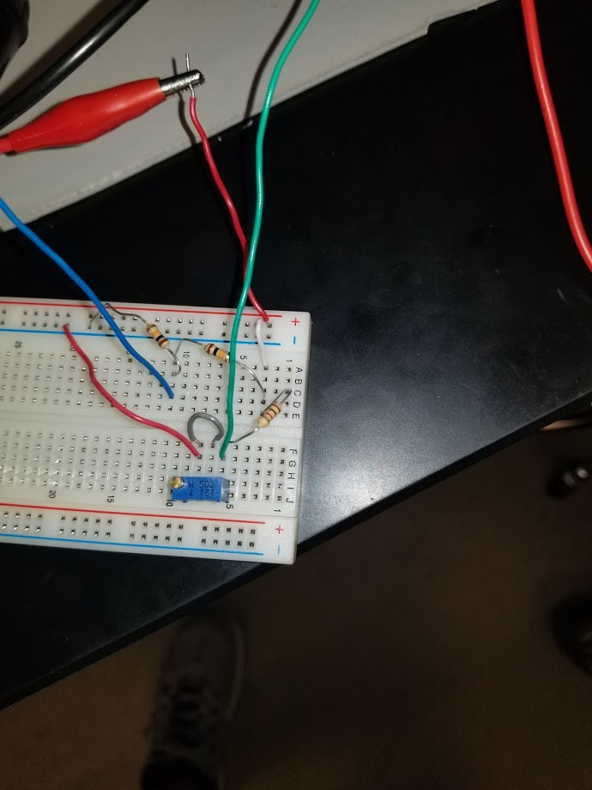
Lab 5- MEMs Variable Resistor (modified)
Observations:
We struggled to get this circuit built properly in order to make it work the way that it was supposed to work. We didn’t know that 2 of the legs of the potentiometer had to jumped out to ground and the other leg had to have power supplied to it. It was neat though that we were able to adjust the resistor to get the desired voltage. As seen in chart beside this we didn’t get the same values from the simulation to the measured. For our null measurement we got it to be 4.5 volts simulated and in the lab we couldn’t get 1 volt. As I stated before we had issues getting the setup correct and even when it was correct we still didn’t get accurate measurements. Had to try multiple different 5k pots.
 | Simulated | Measured
R1 = | 10k Ω | 9923 Ω
R2 = | 10k Ω | 9986 Ω
R3 = | 1k Ω | 982 Ω
R4 =
min | 449.9uV | 0 V
null | 4.5 V | .908 V
max | 7.5 V | 4.698 V
Va - Vb
min | 4.5 V | -4.486 V
null | 0 | .00017 V
max | 3 V | 2.9645 V

Slide 24
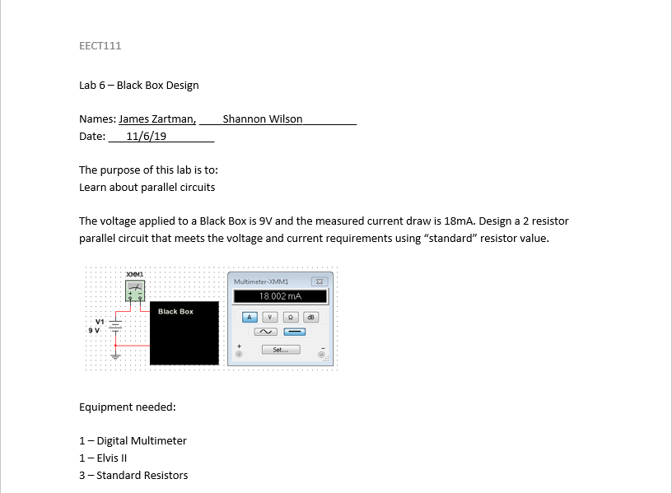
Lab 6- Black box design (parallel circuit)
Objective
  To learn about parallel circuits and be able to figure out the combination of 2 resistors that when hooked up in parallel would make the diagram provided on the lab true.
Equipment Used
  Digital multimeter, wires, DC power source, Bread board, Resistors: 2 - 1k ohm

Slide 25
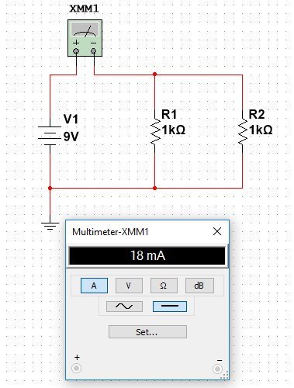
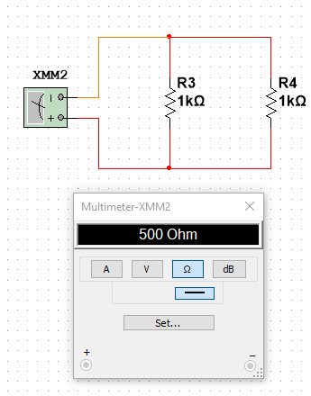
Lab 6- Black box design (parallel circuit)
V1= | 9V
R1= | 1.0E+3Ω
R2= | 1.0E+3Ω
RT= | 500Ω | (B2*B3)/(B2+B3)
IT= | 18.0E-3A | B1/B4
Procedure
  First calculated the Total resistance based on ohms law and solving for resistors in parallel.
  Knowing the total resistance then we could figure out what 2 basic resistors we needed to use to get the correct current.
  Simulated it
  Went to lab and built the circuit and then tested the circuit to see if the measured values lined up with the calculations and the simulation.

Slide 26
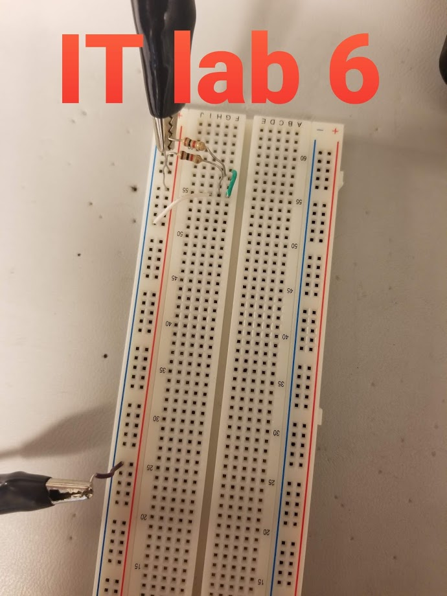
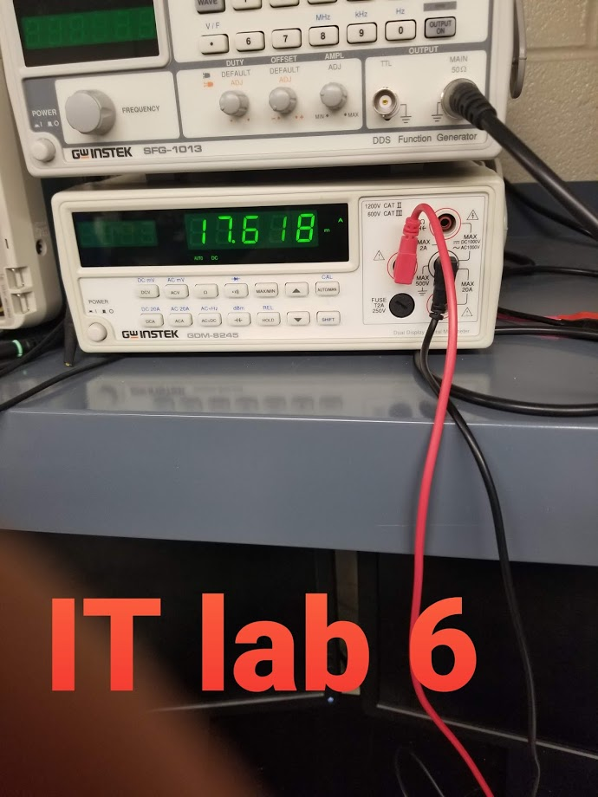
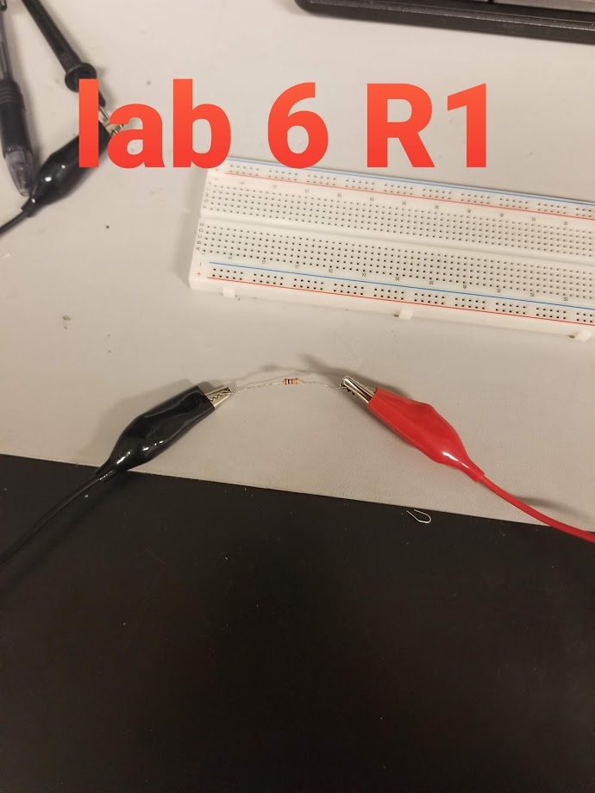
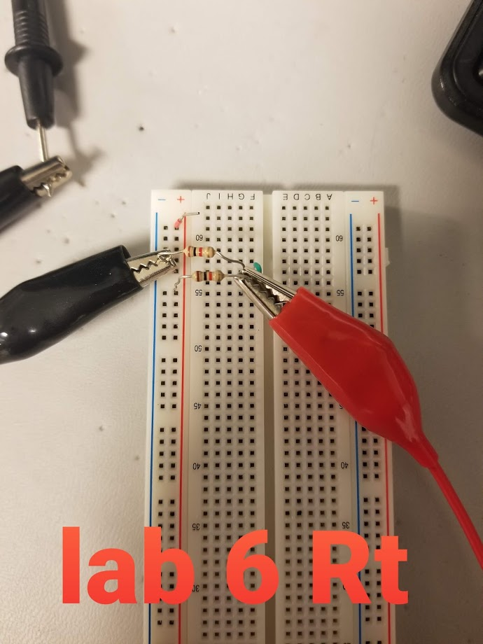
Lab 6- Black box design (parallel circuit)
Pictures of setup and measurements

Slide 27
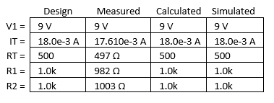
Lab 6- Black box design (parallel circuit)
Observations and Results
  This lab was very similar to Lab #4 in the aspect that we were trying to figure out a combination of resistors, this time in parallel, to give us a certain current.
  We found that the measured numbers from the lab were pretty close to what we calculated and simulated.
  Overall this lab went pretty smooth

Slide 28
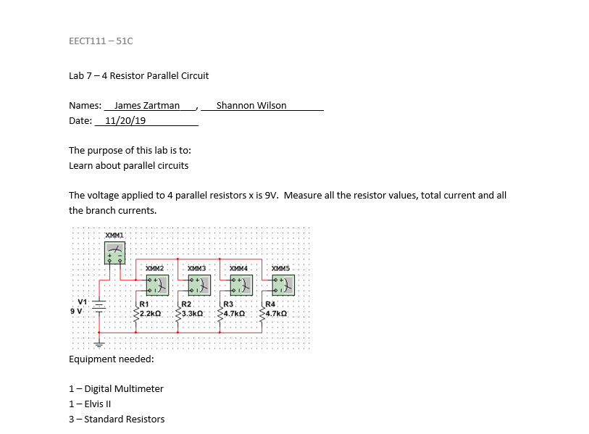
Lab 7- Resistor Parallel Circuit
Objective
  The objective here was for us to learn more about resistors that are in parallel.
Equipment Used
  Digital multimeter, DC power supply, bread board, jumper wires, 4 resistors: 2.2k ohm, 3.3k ohm, and 2-4.7k ohm

Slide 29
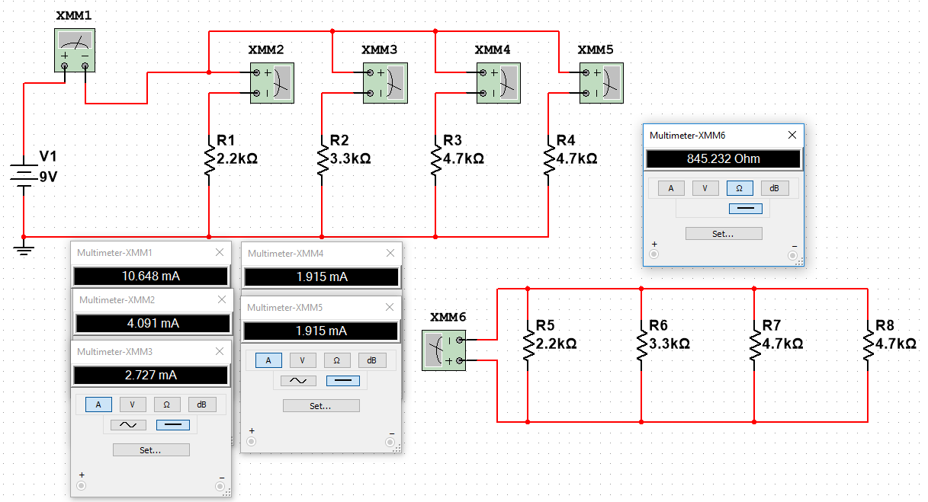
Lab 7- Resistor Parallel Circuit
V1= | 9 | V
R1= | 2.2E+3 | Ω
R2= | 3.3E+3 | Ω
R3= | 4.7E+3 | Ω
R4= | 4.7E+3 | Ω
I1= | 4.1E-3 | A | B1/B2
I2= | 2.7E-3 | A | B1/B3
I3= | 1.9E-3 | A | B1/B4
I4= | 1.9E-3 | A | B1/B5
IT= | 10.6E-3 | A | sum(B6:B9)
RT= | 845.23 | Ω | B1/B10
RT= | 845.23 | Ω | 1/((1/B2)+(1/B3)+(1/B4)+(1/B5))
Procedure
  First we simulated and calculated the values that we needed to find in the classroom.
  Had to figure out the total resistance and did so by using the reciprocal method.
  Then calculated the total current
  From there calculated the current before each resistor by taking the voltage divided by the resistor value that the current had just passed through
  After the calculations were done we simulated the circuit in multisim to see if the values we got were accurate
  The calculations and simulations are shown to the right

Slide 30
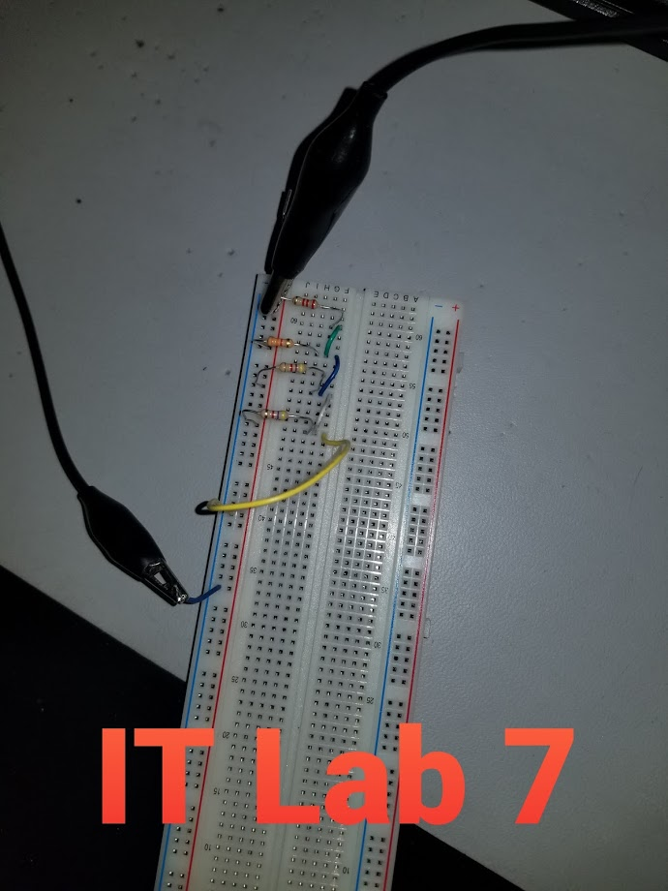
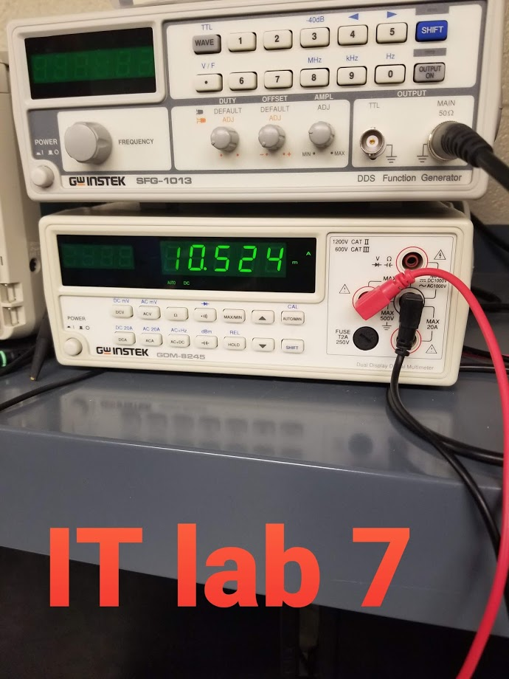
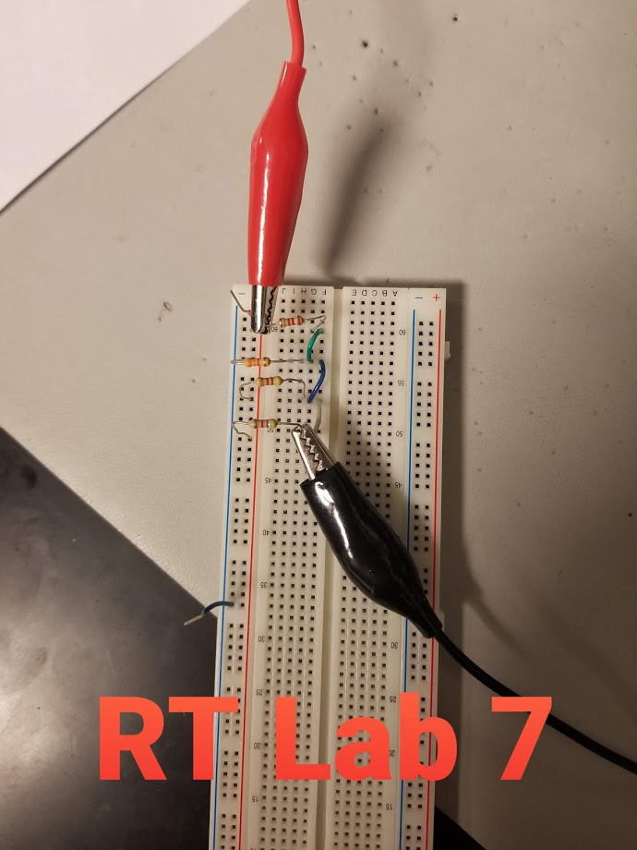
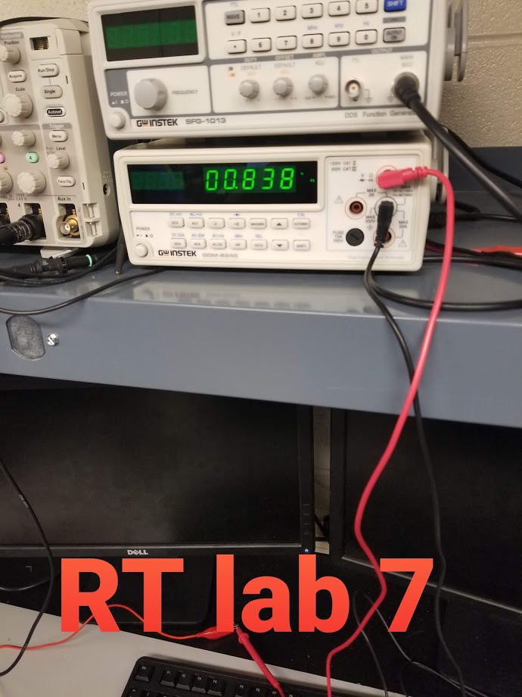
Lab 7- Resistor Parallel Circuit
Procedure
  Went to lab and built the circuit on the bread board by placing the resistors in parallel from one another.
  Used the multimeter to measure the total resistance, total current, and current on each branch of the circuit.
  Took pictures of the setup and some measurments

Slide 31
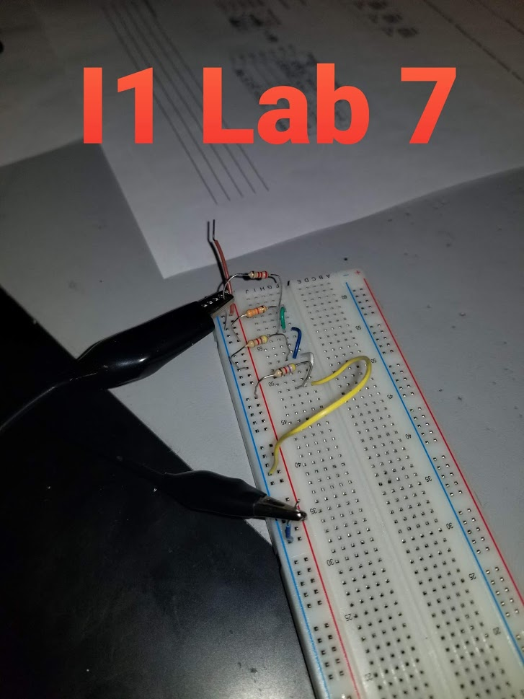
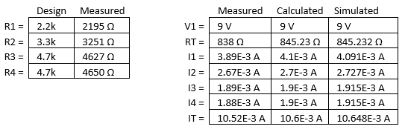
Lab 7- Resistor Parallel Circuit
Observations & Results
  Looking at the tables provided on this slide of the results, we can see that the data is relatively close from measured to the simulated and calculation. Any difference is because the resistors have a tolerance of 5% so they vary in range to their stated value. When these are calculate into the measurements it can skew the data one way or another.
  One issue that my partner and I had was figuring out how to measure the current on each branch. I included a picuture on this slide of how we measured the branch current. We did so by disconnecting the powered side of the resistor and measuring through the rest of the circuit to get the branch current. Once we got one, we connected it back into the circuit and pulled the next one out and measured from that point.

Slide 32
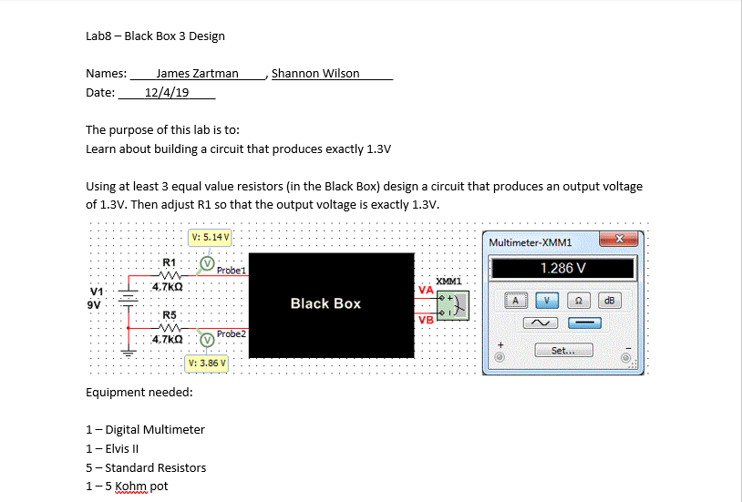
Lab 8- black box design 3
Objective
  The purpose of this lab was to teach us about making a circuit that produced a certain output voltage, in this case 1.3 volts
Equipment Used
  Digital multimeter, DC power supply, bread board, jumper wires, Resistors: 5- 4.7 kohm and 1 5 kohm variable

Slide 33
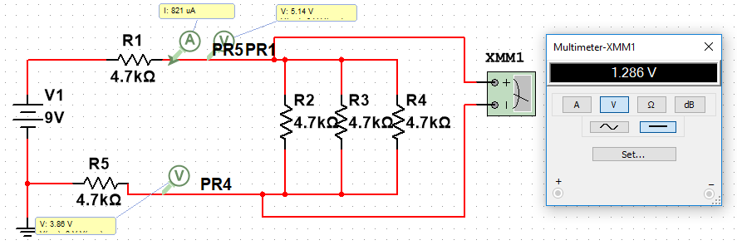
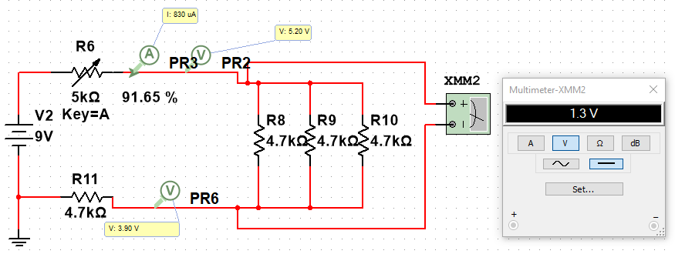
Lab 8- black box design 3
Procedure
  The way we went about doing this lab is we simulated it first in multisim.
  We figured out what combination of resistors would get us close to an output voltage of 1.3 volts. We figured out that putting 3 4.7 kohm resistors in parallel in place of the black box was the solution.
  That setup gave us 1.286 volts
  We then installed a variable resistor in place of resistor 1 in the simulation and adjusted it until we got an exact output voltage of 1.3 volts
  The 5 kohm variable resistor was at 91.65%
  We then went through and did the calculations to verify that we could reproduce the same numbers, and we did
V1= | 9
R1= | 4.7E+3
R2= | 4.7E+3
R3= | 4.7E+3
R4= | 4.7E+3
R5= | 4.7E+3
R34= | 9.4E+3
R234= | 1.6E+3
RT= | 11.0E+3
IT= | 820.7E-6
VA= | 5.143
VB= | 3.857
VA-VB= | 1.286
R1 adj= | 4582.5
RT adj= | 10.8E+3
VA adj | 5.199
VB adj | 3.857
VA-VB adj= | 1.3

Slide 34
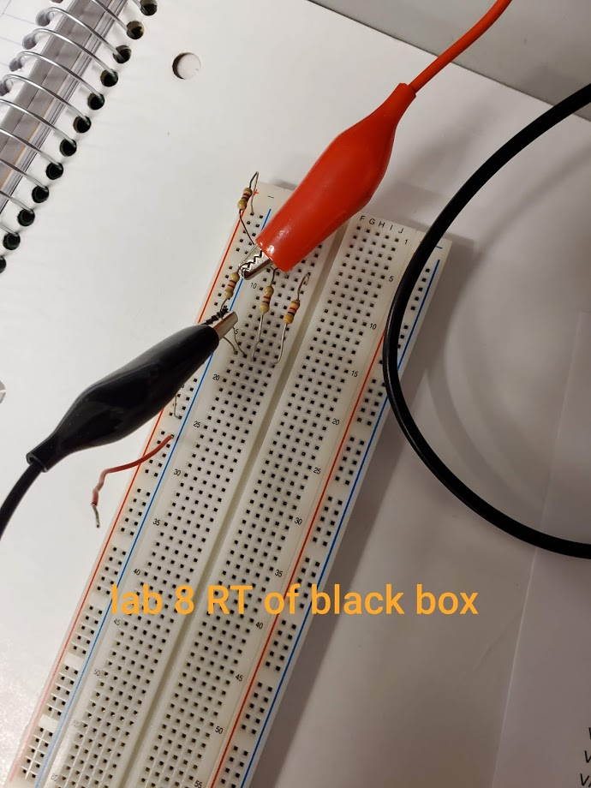
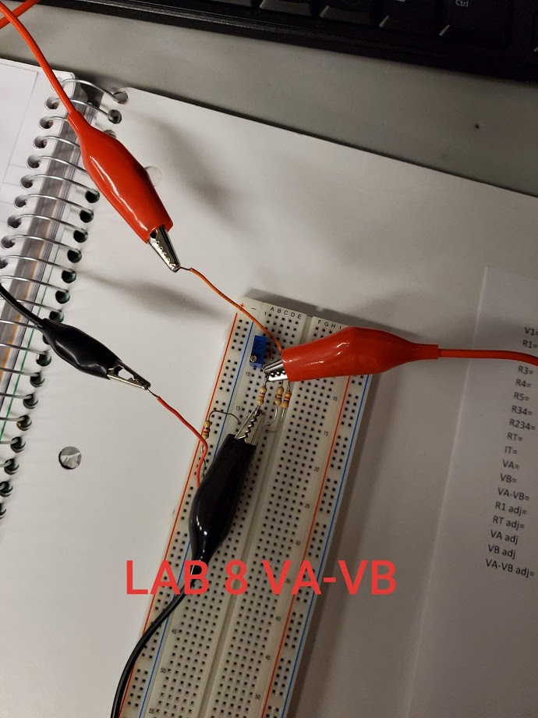
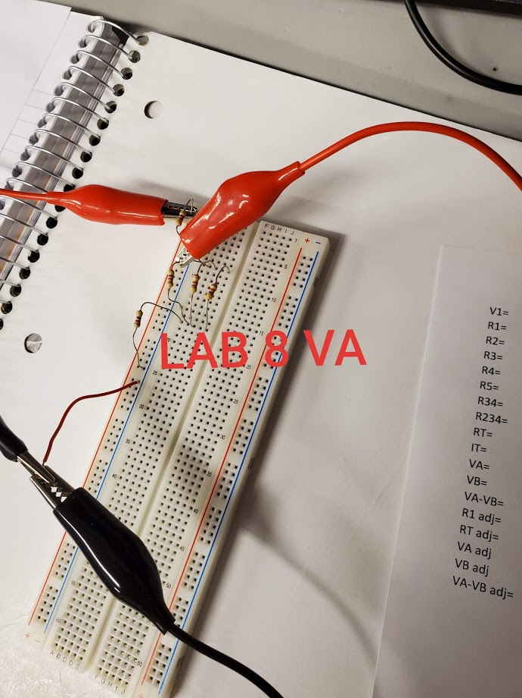
Lab 8- black box design 3
Procedure
  We went to the lab and created the circuit without the variable resistor on the bread board.
  Measured all of the resistors with the multimeter
  Measured the voltages before and after the black box with the multimeter.
  Then put the variable resistor in and adjusted it until our VA-VB was equal to 1.3 volts. Took the variable resistor out and then measured the resistance with the multimeter.

Slide 35
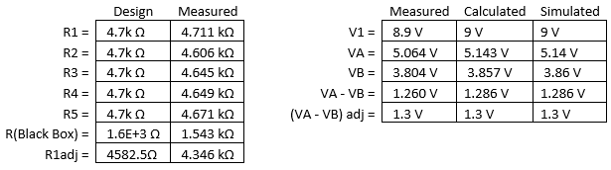
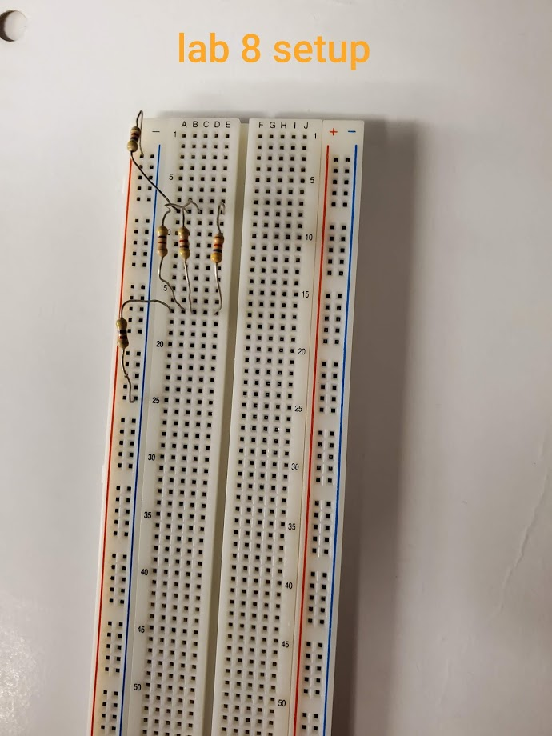
Lab 8- black box design 3
Observations & Results
  When we first did our lab we made the 3 resistors in black box to be 2.4 kohm resistors. 1 in parallel with 2 in series. We figured out the problem and calculations, went to lab to discover we were supposed to use standard resistors. We started out trying to use 3 variable resistors and making them equal 2.4 kohm. It was proving to be way too difficult. We re-grouped and changed our simulation and calculations to standard resistors of 4.7 kohm and all 3 were in parallel. This was much easier lab to achieve at that point then.
  According to the data we collected our simulation and calculation was pretty accurate and our measured values didn’t disappoint. They were close and all made sense

Slide 36
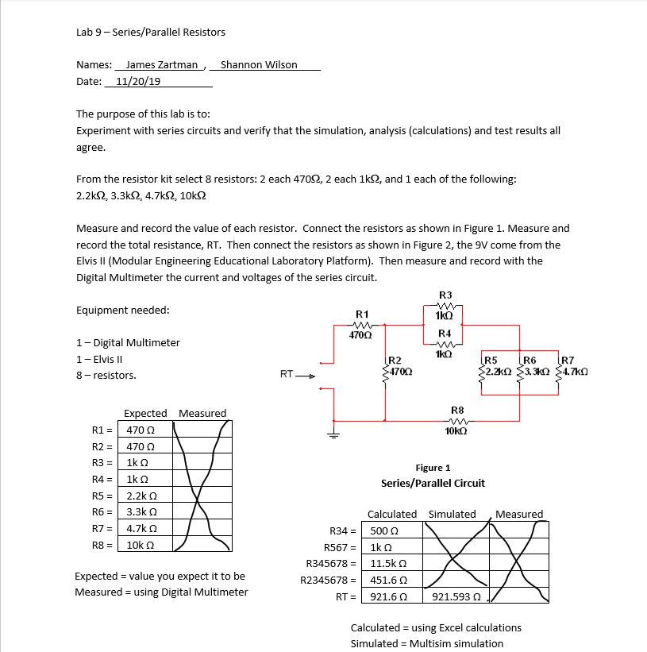
Lab 9- Series/Parallel Resistors
Objective
  The objective of this lab was to experiment with series and parallel combination circuits and apply everything we learned to simulated and calculations for the total resistance and various voltages throughout the circuit. We did not build the circuit in the lab though because of time constraints. Since we didn’t build the circuits there was no equipment used besides excel and multisim

Slide 37
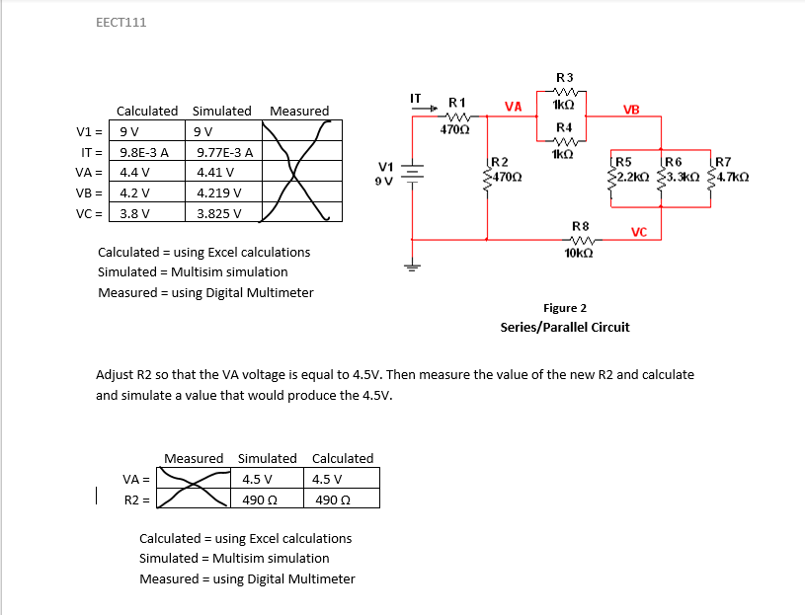
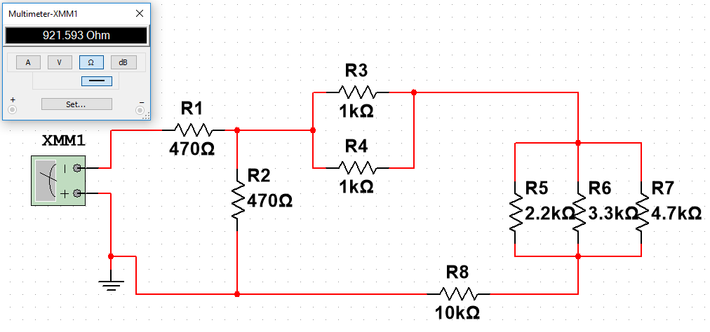
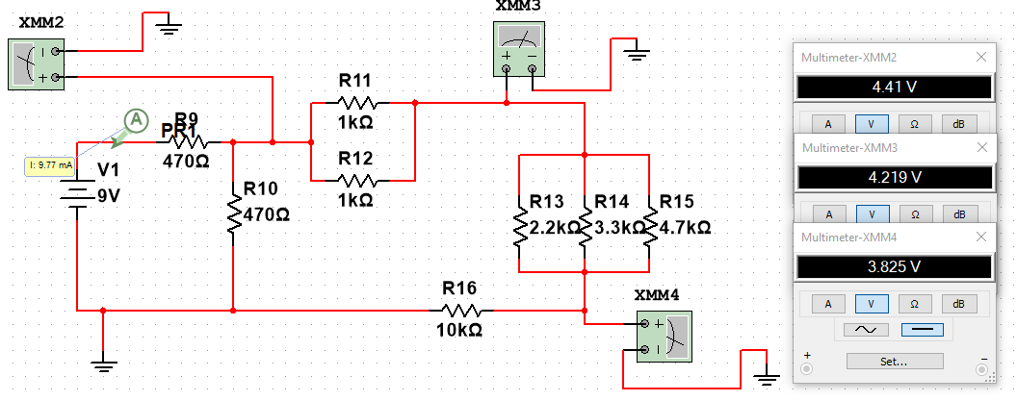
Lab 9- Series/Parallel Resistors
Simulation and charts filled out

Slide 38
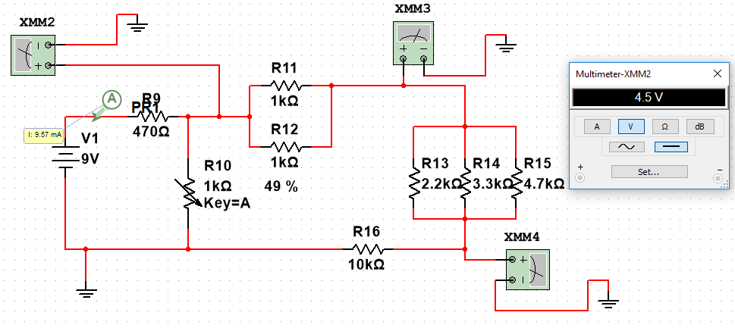
Lab 9- Series/Parallel Resistors
Simulation after adjusting R2 to get VA to equal exactly 4.5 volts
As you can see a 1 kohm variable resistor needed to be set at 49% or 490 ohm to get VA to equal 4.5 Volts
All the calculations solved for in excel for this lab
Observation: As for observations for this lab there wasn’t much to observe, just crunch some numbers. We struggled to figure out the voltages for VB and VC. Once we figured out that we use the previous voltage found in the calculation that helped us instead of using V1 of 9 volts.
R1= | 470
R2= | 470
R3= | 1.0E+3
R4= | 1.0E+3
R5= | 2.2E+3
R6= | 3.3E+3
R7= | 4.7E+3
R8= | 10.0E+3
R34= | 500
R567= | 1.0E+3
R345678= | 11.5E+3
R2345678= | 451.6E+0
RT= | 921.6E+0
V1= | 9
IT= | 9.8E-3
VA= | 4.4E+0
VB= | 4.2E+0
VC= | 3.8E+0
R5678 | 11.0E+3
R25678= | 5.2E+3
V2= | 4.4E+0

Slide 39
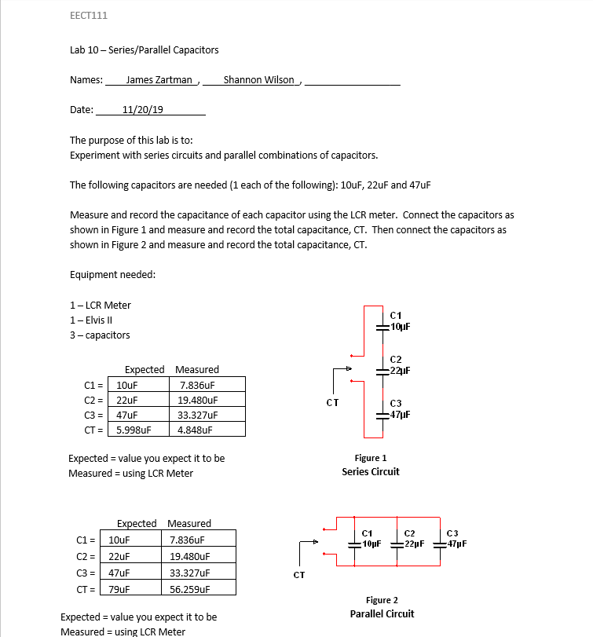
Lab 10- Series/parallel capacitors
Objective
  The objective of this lab was to teach us about how capacitors behave in series and in parallel
Equipment used
  LCR meter, bread board, 3 capacitors: 10uF, 22uF, and 47uF, used multisim and excel as well
c1= | 10 | uF
c2= | 22 | uF
c3= | 47 | uF
CT in series = | 5.99768 | uF
CT in parallel= | 79 | uF

Slide 40
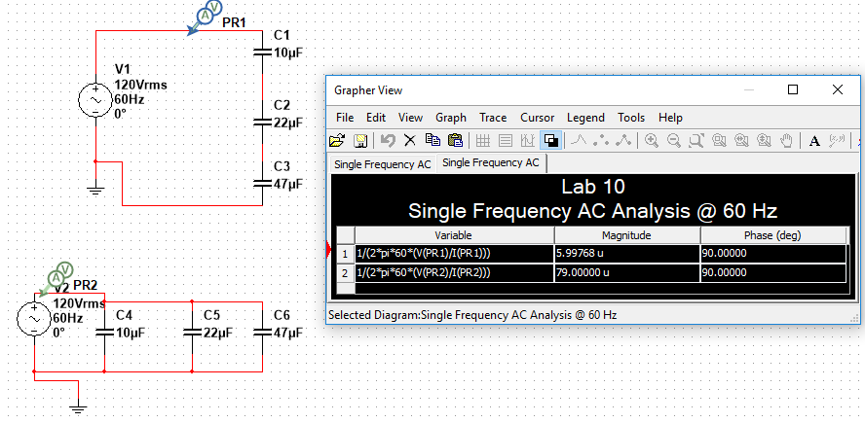

Lab 10- Series/parallel capacitors
Procedure
  We simulated and calculated the results that we were looking for in multisim and excel.
  Calculating the total capacitance is just like resistor, but when capacitors are in series they solve like resistors in parallel.
  Since multisim doesn’t have an LCR meter we had to calculate the total capacitance a different way by using the equation C=$\frac{1}{2πf\left(\frac{V}{A}\right)}$ to solve for the capacitance, which can be seen here to the right in the simulation.
  We used 60Hz for the frequency and voltage and amp probes to compute the voltage(V) and current(A).
As you can see in the grapher view under the magnitude it displays the total capacitance for the series (1) and parallel (2) circuits.

Slide 41



Lab 10- Series/parallel capacitors
Procedure cont.
  After simulation we went to the lab to build the circuits and record the data.
  This lab was pretty straight forward because we had the LCR meter
  We had to switch the mode on the LCR meter to read capacitance
  Then measured each capacitor and recorded their values
  Put the capacitors in series and parallel on the bread board and measured the total capacitance for each circuit
  To the right are some pictures of the setup and measuring

Slide 42
Lab 10- Series/parallel capacitors
Observations
  The results of the measurements were on the first slide of this lab
  Some things that we noticed is that the capacitors don’t have as tight of a tolerance as the resistors do. For this reason some of the data that we got for the measured data is a little far off from what we simulated and calculated. Wear and tear on parts and human error could attribute to this sort of error.

Slide 43

Lab 11- RC Lab
Objective
  The purpose of this lab was to get give us experience with a resistor and capacitor combination circuit. Also supposed to hook circuit up to function generator to change the frequency to see how it changes the output voltage.
Equipment Used
  LCR meter, digital meter, function generator, Oscilloscope, 1k ohm resistor, and 3 capacitors: .47uF, 1uF, and 2.2uF

Slide 44



Lab 11- RC Lab
Procedure
  First we simulated the circuit in Multisim and we created the chart to input the data in excel even though there were no calculations necessarily needed. We only did a variety of the frequencies as well
  To the right is a sample of a few of the frequencies in Multisim at 10Hz, 300Hz, and 10kHz

Slide 45


Lab 11- RC Lab
Procedure cont.
  After simulating we went to the lab and measured all the capacitors with the LCR meter and measure the resistor with the multi meter.
  We then hooked up the circuit and set the function generator to send a voltage of 1 volt peak to peak.
  Set up the oscilloscope to measure voltage in and out peak to peak.
  Proceeded to measure all 3 capacitors at the frequencies we decided to measure and recorded the data.
  To the right are a few pictures of how we set up the circuit and a picture of the Oscilloscope measuring the input voltage (yellow wave) and output voltage (blue wave).

Slide 46
Lab 11- RC Lab
Calculations and Graph
  Below is the chart and graph we used to collect the data
  We also computed the % error between the expected and measured output voltages.
Output Voltage C=0.47µF |  |  |  |  | Output Voltage C= 1µF |  |  |  | Output Voltage C= 2.2µF
 | Expected | Measured |  |  | Expected | Measured |  |  | Expected | Measured
Frequency | Output voltage (mV) | Input Voltage (mV) | Output Voltage (mV) | % Error | Output voltage (mV) | Input Voltage (mV) | Output Voltage (mV) | % Error | Output voltage (mV) | Input Voltage (mV) | Output Voltage (mV) | % Error
10 | 996 | 999 | 1004 | 0.803213 | 995 | 999 | 1004 | 0.904523 | 990 | 999 | 1002 | 1.212121
50 | 998 | 995 | 1002 | 0.400802 | 954 | 995 | 984 | 3.144654 | 819 | 995 | 832 | 1.587302
100 | 958 | 998 | 984 | 2.713987 | 845 | 998 | 872 | 3.195266 | 585 | 998 | 592 | 1.196581
200 | 860 | 999 | 872 | 1.395349 | 621 | 999 | 656 | 5.636071 | 338 | 999 | 360 | 6.508876
300 | 747 | 999 | 752 | 0.669344 | 467 | 999 | 504 | 7.922912 | 234 | 999 | 256 | 9.401709
700 | 434 | 999 | 448 | 3.225806 | 221 | 999 | 272 | 23.07692 | 102 | 999 | 132 | 29.41176
800 | 388 | 999 | 400 | 3.092784 | 194 | 999 | 240 | 23.71134 | 89.7 | 999 | 116 | 29.31996
900 | 350 | 999 | 364 | 4 | 173 | 999 | 220 | 27.16763 | 79.8 | 999 | 112 | 40.35088
1000 | 319 | 999 | 332 | 4.075235 | 156 | 999 | 206 | 32.05128 | 71.9 | 999 | 93.6 | 30.18081
2000 | 166 | 999 | 186 | 12.04819 | 79 | 999 | 116 | 46.83544 | 36 | 999 | 68 | 88.88889
6000 | 56.2 | 999 | 71.2 | 26.69039 | 26.4 | 999 | 48 | 81.81818 | 12 | 999 | 27.2 | 126.6667
7000 | 48.2 | 999 | 63.2 | 31.12033 | 22.6 | 999 | 42.2 | 86.72566 | 10.3 | 999 | 28 | 171.8447
8000 | 42.2 | 999 | 56.8 | 34.59716 | 19.8 | 999 | 39.2 | 97.9798 | 9 | 999 | 2506 | 27744.44
9000 | 37.5 | 999 | 52 | 38.66667 | 17.6 | 999 | 36 | 104.5455 | 8 | 999 | 24.8 | 210
10000 | 33.7 | 999 | 48.8 | 44.80712 | 15.9 | 999 | 46 | 189.3082 | 7.2 | 999 | 24 | 233.3333

Slide 47
Lab 11- RC Lab
Observations
  This Lab was seemingly challenging at the start because neither me or my partner had new how to set up the oscilloscope. Once we figured it out the lab went pretty smoothly.
  There were a lot of the values of frequency that the output voltage was close to what we expected, but there were also a lot that seemed to be pretty far off. We calculated the percent error of the measured output voltage to the expected voltage. It seemed to follow that as the frequency increased the percent error increased alarmingly fast, particularly after we got past about 700Hz. The .47uF capacitor had the best results.

Slide 48

Lab 12- Series/Parallel inductors
Objective
  The purpose of this lab was to get us acquainted with inductors in series and parallel circuits and to learn how to measure them
Equipment used
  LCR meter, bread board, jumper wires, and 3 inductors: 1mH, 2.2mH, and 4.7mH

Slide 49


Lab 12- Series/Parallel inductors
Procedure
  We first simulated the circuits and did the calculations in excel.
  In order for Inductors to be calculated in multisim they have to have some type of resistance to them. When simulating we added small resistors before each Inductor.
  Inductors are just like resistors when trying to find the total Inductance.
L1= | 1.0E-3
L2= | 2.2E-3
L3= | 4.7E-3
LT= | 7.9E-3
Series inductor
L1= | 1.0E-3
L2= | 2.2E-3
L3= | 4.7E-3
LT= | 599.8E-6
Parallel inductor

Slide 50



Lab 12- Series/Parallel inductors
Procedure cont.
  Built up the circuits in the lab and then measured them with the LCR meter
Observation
  This lab went smoothly with no issues. The Inductors in the lab already have resistance built into them. At first we started getting resistors out to build up our circuit, but found out we didn’t need them.

Slide 51

Lab 13- RL Lab
Objective
  The purpose of this lab was to have us experiment with RL (resistor and inductor) circuits. Also supposed to hook circuit up to function generator to change the frequency to see how it changes the output voltage.
Equipment Used
  Digital Multimeter, Bread board, function generator, Oscilloscope, LCR meter, 1-100ohm resistor, 3 different inductors: 1mH, 2.2mH, and 4.7mH

Slide 52



Lab 13- RL Lab
Procedure
  First we simulated the circuit in Multisim and we created the chart to input the data in excel even though there were no calculations necessarily needed. We only did a variety of the frequencies as well
  To the right is a sample of a few of the frequencies in Multisim at 100Hz, 1000Hz, and 10kHz

Slide 53


Lab 13- RL Lab
Procedure cont.
  After simulating we went to the lab and measured all the Inductors with the LCR meter and measure the resistor with the multi meter.
  We then hooked up the circuit and set the function generator to send a voltage of 1 volt peak to peak.
  Set up the oscilloscope to measure voltage in and out peak to peak.
  Proceeded to measure all 3 Inductors at the frequencies we decided to measure and recorded the data.
  To the right are a few pictures of how we set up the circuit and a picture of the Oscilloscope measuring the input voltage (yellow wave) and output voltage (blue wave).

Slide 54
Lab 13- RL Lab
Calculations and Graph
  Below is the chart and graph we used to collect the data
  We also computed the % error between the expected and measured output voltages.
Output Voltage C=4.7mH |  |  |  |  | Output Voltage C= 1mH |  |  |  | Output Voltage C= 2.2mH
 | Expected | Measured |  |  | Expected | Measured |  |  | Expected | Measured
Frequency | Output voltage (mV) | Input Voltage (mV) | Output Voltage (mV) | % Error | Output voltage (mV) | Input Voltage (mV) | Output Voltage (mV) | % Error | Output voltage (mV) | Input Voltage (mV) | Output Voltage (mV) | % Error
10 | 5.92 | 1000 | 33.6 | 467.57 | 1.26 | 160 | 22.4 | 1677.78 | 2.77 | 160 | 23.2 | 737.55
50 | 29.5 | 1000 | 23.2 | 21.36 | 6.29 | 940 | 65.2 | 936.57 | 13.8 | 920 | 75 | 443.48
100 | 59.1 | 920 | 120 | 103.05 | 12.6 | 920 | 58.4 | 363.49 | 27.6 | 920 | 83.2 | 201.45
200 | 118 | 920 | 130 | 10.17 | 25.1 | 920 | 64.8 | 158.17 | 55.3 | 920 | 72 | 30.20
300 | 177 | 920 | 166 | 6.21 | 37.6 | 920 | 52 | 38.30 | 82.9 | 920 | 75.2 | 9.29
700 | 406 | 920 | 240 | 40.89 | 88 | 920 | 82.6 | 6.14 | 193 | 900 | 136 | 29.53
800 | 461 | 920 | 268 | 41.87 | 101 | 940 | 114 | 12.87 | 220 | 900 | 134 | 39.09
900 | 514 | 940 | 284 | 44.75 | 113 | 920 | 100 | 11.50 | 247 | 900 | 148 | 40.08
1000 | 566 | 940 | 280 | 50.53 | 126 | 920 | 115 | 8.73 | 274 | 920 | 178 | 35.04
2000 | 1002 | 960 | 480 | 52.10 | 250 | 920 | 190 | 24.00 | 535 | 920 | 260 | 51.40
6000 | 1740 | 1140 | 960 | 44.83 | 707 | 940 | 336 | 52.48 | 1280 | 1000 | 600 | 53.13
7000 | 1800 | 1160 | 1.04 | 99.94 | 805 | 940 | 376 | 53.29 | 1390 | 1040 | 720 | 48.20
8000 | 1840 | 1200 | 1080 | 41.30 | 898 | 940 | 424 | 52.78 | 1480 | 1080 | 760 | 48.65
9000 | 1870 | 1200 | 1120 | 40.11 | 987 | 960 | 464 | 52.99 | 1560 | 1080 | 840 | 46.15
10000 | 1890 | 1220 | 1140 | 39.68 | 1070 | 980 | 512 | 52.15 | 1620 | 1100 | 880 | 45.68

Slide 55
Lab 13- RL Lab
Observation
  This lab was identical to lab 11 except instead of a capacitor we used an inductor. So it was not too hard to set the circuit up and get the input and output voltages off of the oscilloscope. The numbers that we got though were pretty far off on a lot of them. Not sure if its because of the noise or interference that happens with an Inductor versus a capacitor or if that’s even a thing. But on the previous slide you can see the percent error that we calculated and there were only a few that were less than 10 % error, but lots that were over 100% error.

